Slide 1
Multiple-Layer Networks
and
Backpropagation Algorithms

Slide 2
Multiple-Layer Networks and
Backpropagation Algorithms
Backpropagation is the generalization of the Widrow-Hoff learning rule to multiple-layer networks and nonlinear differentiable transfer functions.
Input vectors and the corresponding target vectors are used to train a network until it can approximate a function, associate input vectors with specific output vectors, or classify input vectors in an appropriate way as defined by you.

Slide 3
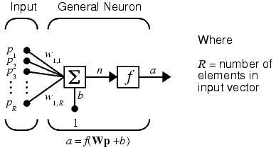
Architecture
Neuron Model
An elementary neuron with R inputs is shown below. Each input is weighted with an appropriate w. The sum of the weighted inputs and the bias forms the input to the transfer function f. Neurons can use any differentiable transfer function f to generate their output.

Slide 4
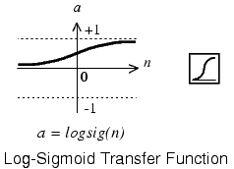
Architecture
Neuron Model
Transfer Functions (Activation Function)
Multilayer networks often use the log-sigmoid transfer function logsig.
The function logsig generates outputs between 0 and 1 as the neuron's net input goes from negative to positive infinity

Slide 5
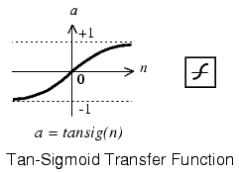
Architecture
Neuron Model
Transfer Functions (Activation Function)
Alternatively, multilayer networks can use the tan-sigmoid transfer function-tansig.
The function logsig generates outputs between -1 and +1 as the neuron's net input goes from negative to positive infinity

Slide 6
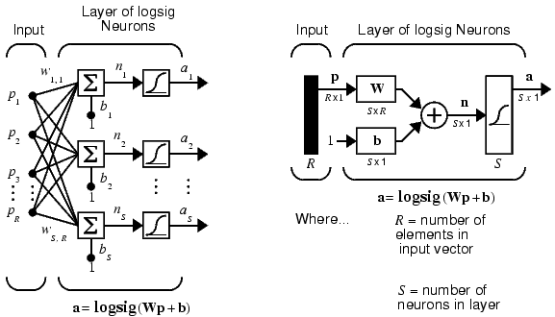
Architecture
Feedforward Network
A single-layer network of S logsig neurons having R inputs is shown below in full detail on the left and with a layer diagram on the right.

Slide 7
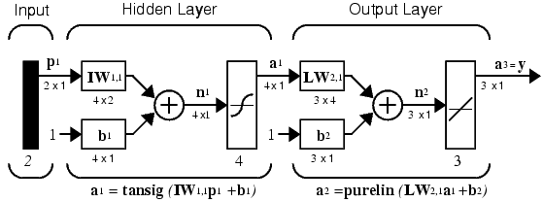
Architecture
Feedforward Network
Feedforward networks often have one or more hidden layers of sigmoid neurons followed by an output layer of linear neurons.
Multiple layers of neurons with nonlinear transfer functions allow the network to learn nonlinear and linear relationships between input and output vectors.
The linear output layer lets the network produce values outside the range -1 to +1. On the other hand, if you want to constrain the outputs of a network (such as between 0 and 1), then the output layer should use a sigmoid transfer function (such as logsig).

Slide 8
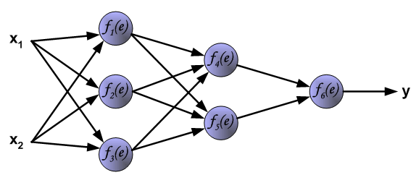
Learning Algorithm:
Backpropagation
The following slides describes teaching process of multi-layer neural network employing backpropagation algorithm. To illustrate this process the three layer neural network with two inputs and one output,which is shown in the picture below, is used:

Slide 9
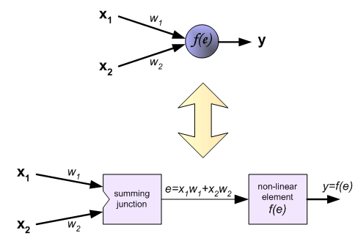
Learning Algorithm:
Backpropagation
Each neuron is composed of two units. First unit adds products of weights coefficients and input signals. The second unit realise nonlinear function, called neuron transfer (activation) function. Signal e is adder output signal, and y = f(e) is output signal of nonlinear element. Signal y is also output signal of neuron.

Slide 10
Learning Algorithm:
Backpropagation
To teach the neural network we need training data set. The training data set consists of input signals (x₁ and x₂ ) assigned with corresponding target (desired output) z.
The network training is an iterative process. In each iteration weights coefficients of nodes are modified using new data from training data set. Modification is calculated using algorithm described below:
Each teaching step starts with forcing both input signals from training set. After this stage we can determine output signals values for each neuron in each network layer.

Slide 11
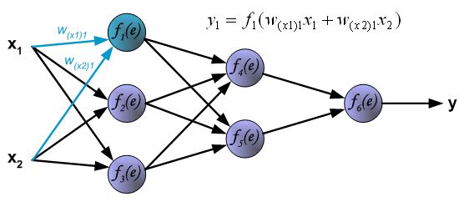
Learning Algorithm:
Backpropagation
Pictures below illustrate how signal is propagating through the network, Symbols w_{(xm)n} represent weights of connections between network input x_{m} and neuron n in input layer. Symbols y_{n} represents output signal of neuron n.

Slide 12
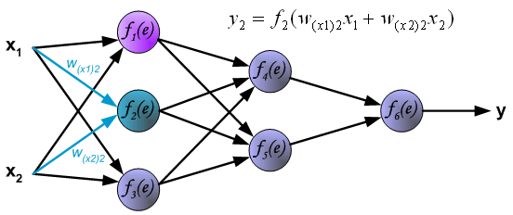
Learning Algorithm:
Backpropagation

Slide 13
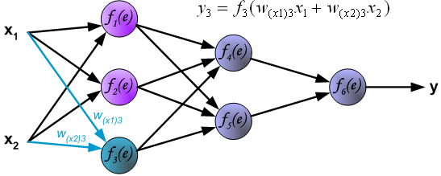
Learning Algorithm:
Backpropagation

Slide 14
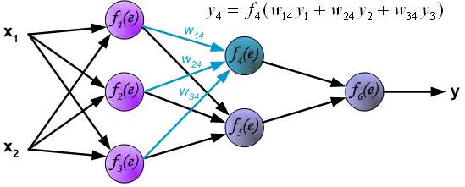
Learning Algorithm:
Backpropagation
Propagation of signals through the hidden layer. Symbols w_{mn} represent weights of connections between output of neuron m and input of neuron n in the next layer.

Slide 15
Learning Algorithm:
Backpropagation

Slide 16
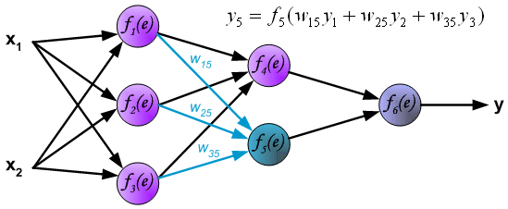
Learning Algorithm:
Backpropagation

Slide 17
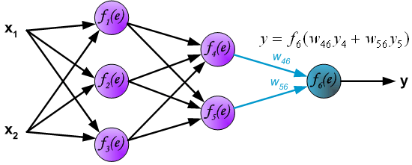
Learning Algorithm:
Backpropagation
Propagation of signals through the output layer.

Slide 18
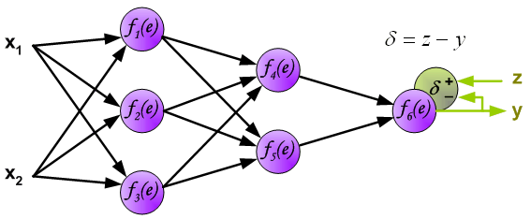
Learning Algorithm:
Backpropagation
In the next algorithm step the output signal of the network y is compared with the desired output value (the target), which is found in training data set. The difference is called error signal d of output layer neuron

Slide 19
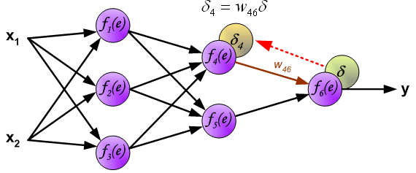
Learning Algorithm:
Backpropagation
The idea is to propagate error signal d (computed in single teaching step) back to all neurons, which output signals were input for discussed neuron.

Slide 20
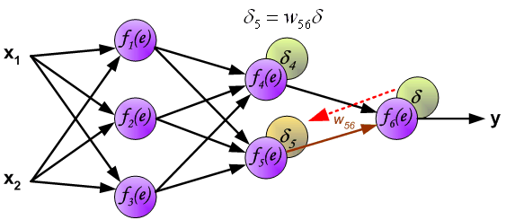
Learning Algorithm:
Backpropagation
The idea is to propagate error signal d (computed in single teaching step) back to all neurons, which output signals were input for discussed neuron.

Slide 21
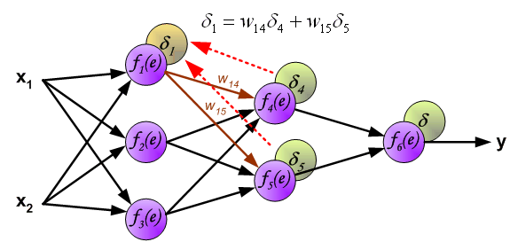
Learning Algorithm:
Backpropagation
The weights' coefficients w_{mn} used to propagate errors back are equal to this used during computing output value. Only the direction of data flow is changed (signals are propagated from output to inputs one after the other). This technique is used for all network layers. If propagated errors came from few neurons they are added. The illustration is below:

Slide 22
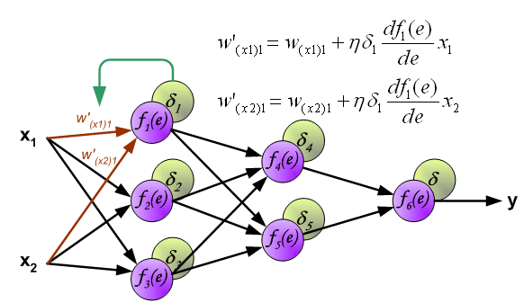
Learning Algorithm:
Backpropagation
When the error signal for each neuron is computed, the weights coefficients of each neuron input node may be modified. In formulas below df(e)/de represents derivative of neuron activation function (which weights are modified).

Slide 23
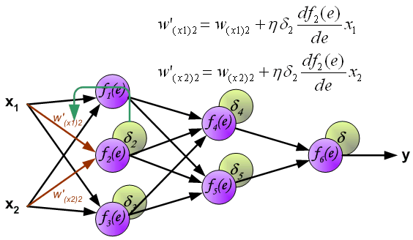
Learning Algorithm:
Backpropagation
When the error signal for each neuron is computed, the weights coefficients of each neuron input node may be modified. In formulas below df(e)/de represents derivative of neuron activation function (which weights are modified).

Slide 24
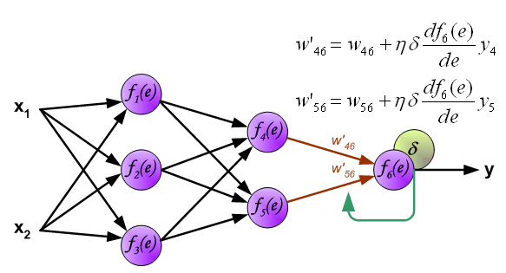
Learning Algorithm:
Backpropagation
When the error signal for each neuron is computed, the weights coefficients of each neuron input node may be modified. In formulas below df(e)/de represents derivative of neuron activation function (which weights are modified).

Slide 25
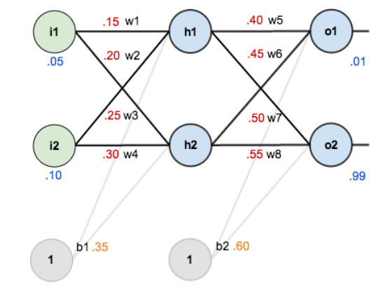
Example

Slide 26
Calculation forward pass
net_{h1}=w₁*i₁+w₂*i₂+b₁*1
net_{h1}=0.15*0.05+0.2*0.1+0.35*1=0.3775
out_{h1}=1/1+e^{-neth1}=1/1+e-^{0.3775}=0.5932
out_{h2}=0.5968
net_{o1}=w₅*out_{h1}+w₆*out_{h2}+b₂*1
out_{o1}=1/1+e^{-neto1}=.7513
out_{o2}=0.7729

Slide 27
Calculating Error
E_{total}=sum(1/2(target-output)²)
For example, the target output for is 0.01 and 0.99 but the neural network output 0.7513, therefore its error is:0.7729
E_{o1}=1/2(target-output)² =1/2(0.01- 0.7513) ²
=0.2748
E₀₂=0.02356
E_{total}=E_{o1}+E₀₂=0.29837

Slide 28
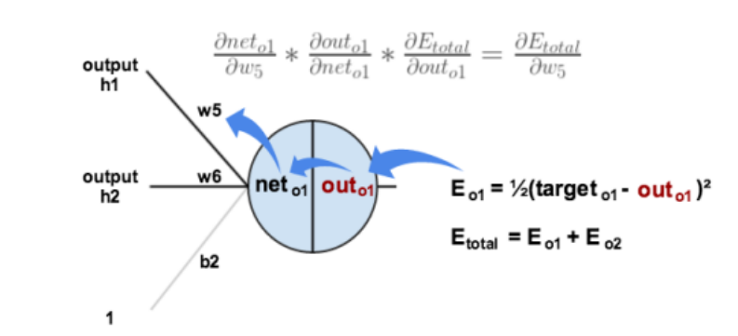
The Backward Pass
By Applying Chain Rule

Slide 29
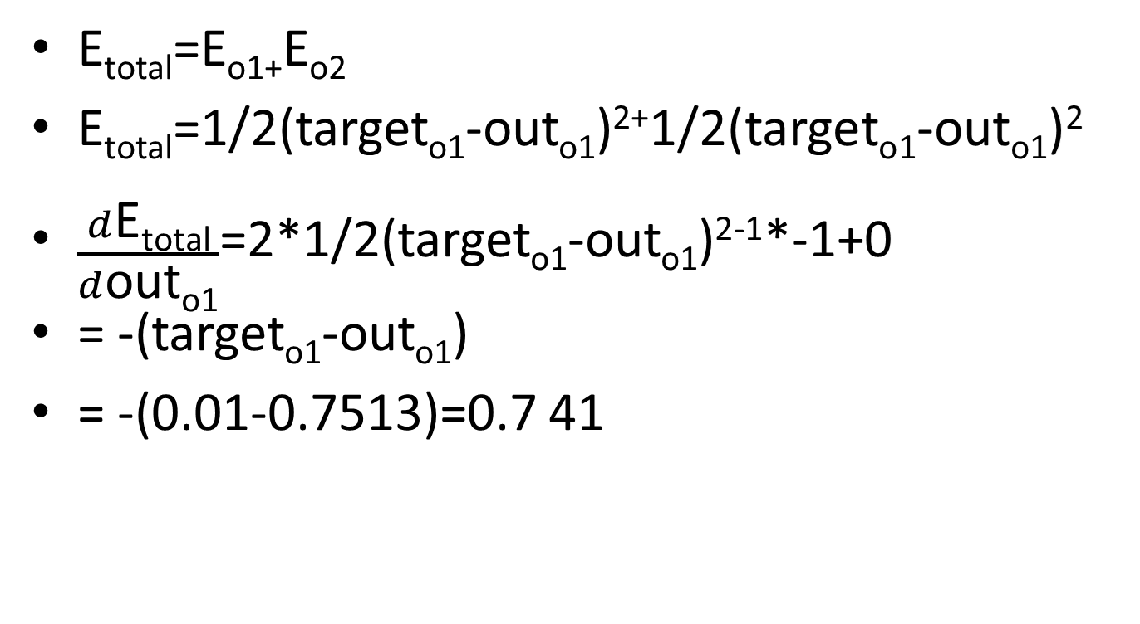
The Backward Pass

Slide 30
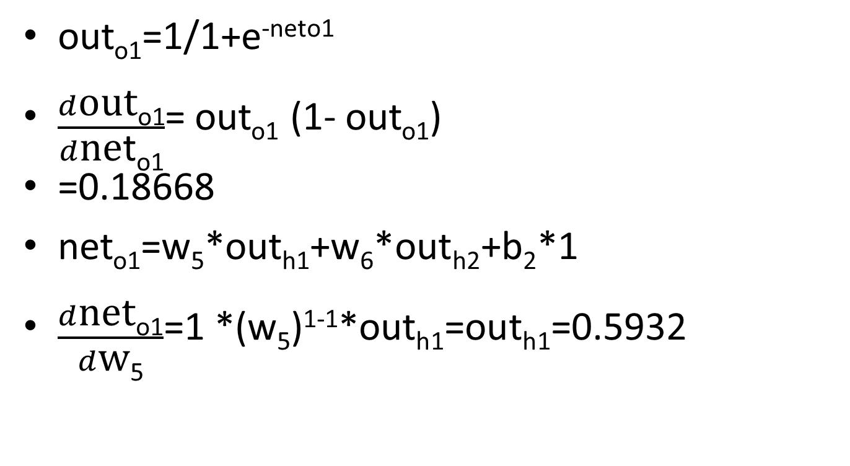
The Backward Pass

Slide 31
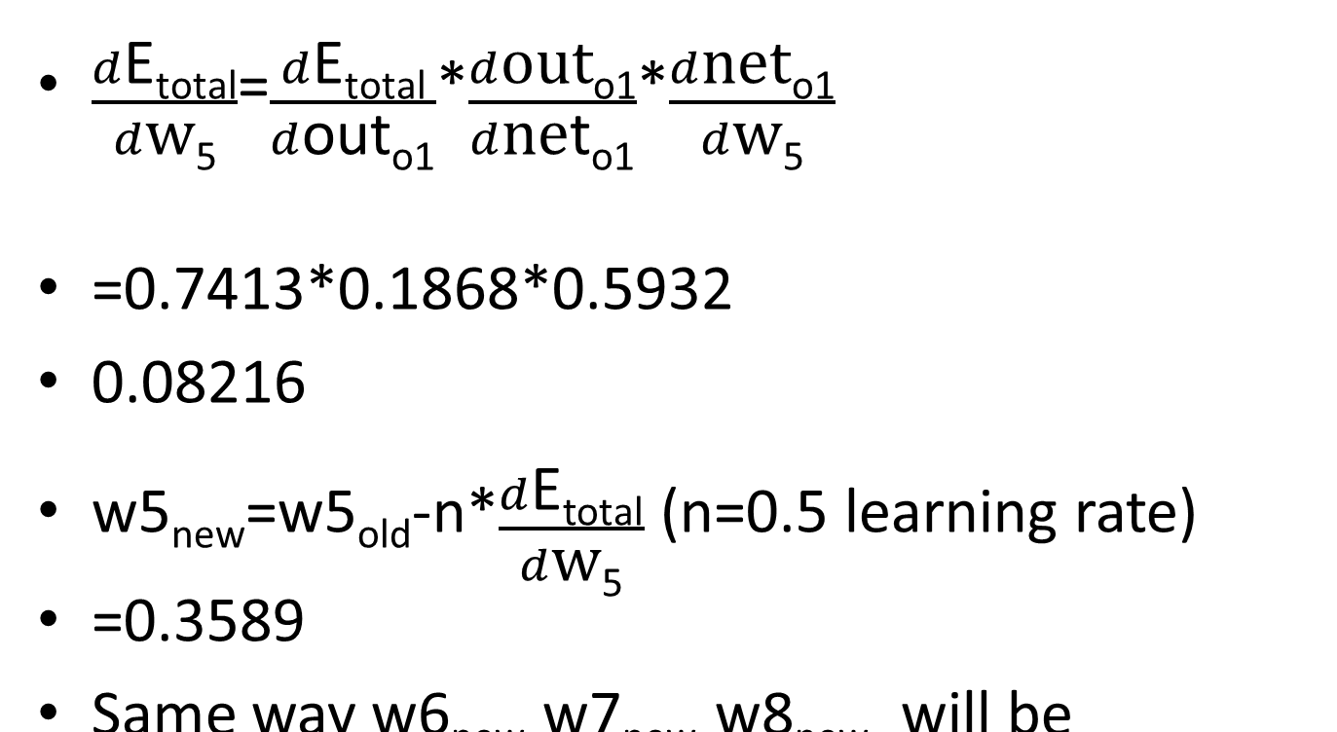
Putting all it together

Slide 32
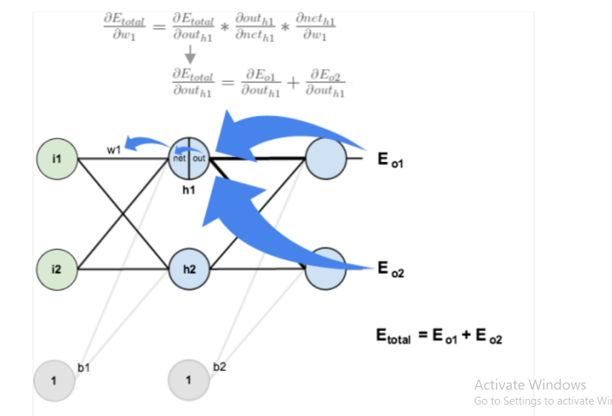
Back Pass at Hidden Layer

Slide 33
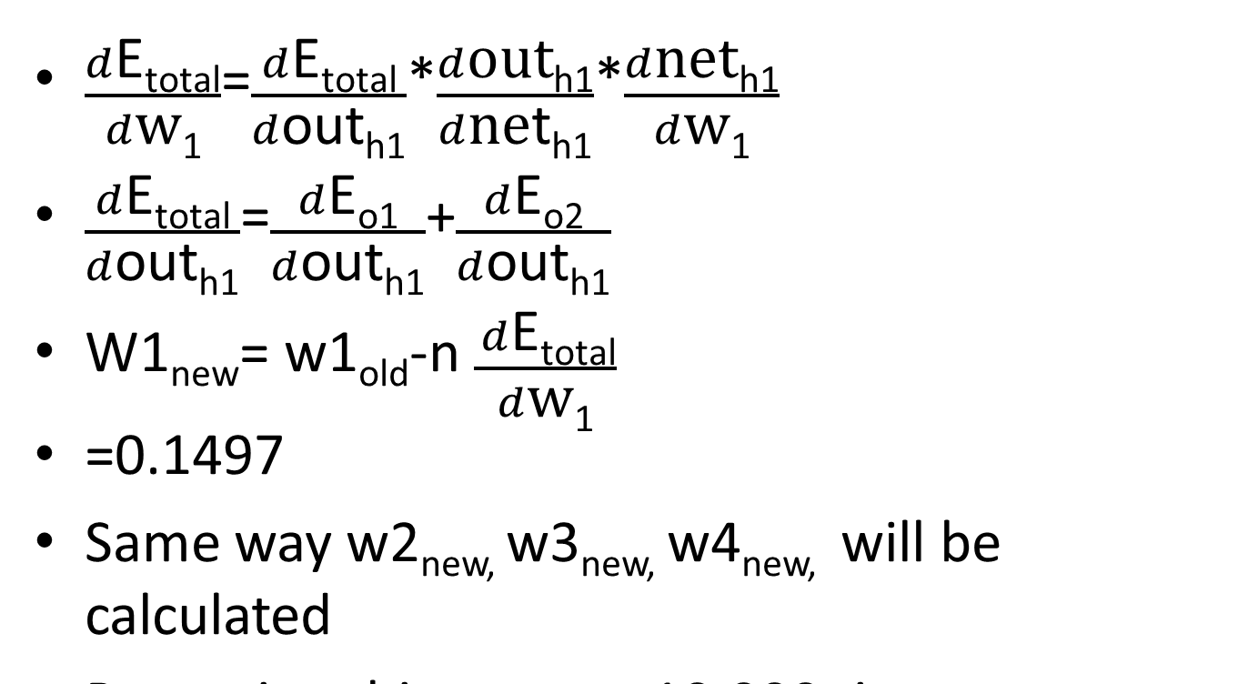
Back Pass at Hidden Layer

